Slide 1
Leveraging open source tool to maximise your investments in M365✨
Dan Toft & Kasper Larsen
MVP and PnP Core team members

Slide 2







Kasper Larsen (He/Him)
kasperbolarsen
PnP Modern Search & PnP Script Samples
Odense, Denmark
https://m365thinking.com/blog
@kasperlarsen.bsky.social
🏢
Fellowmind
5 March 2025
Notes:
Kasper

Slide 3


Our IT journeys both started around Y2K

Slide 4




Dan Toft (He/Him)
🏢
Evobis ApS
@Tanddant
Herning, Denmark
@Dan-Toft.dk
/in/dan-toft
M365 Development & Microsoft Graph MVP
📍
Notes:
Dan

Slide 5





















Big Thank You to Our Sponsors

Slide 6
Let’s talk open source
Notes:
Dan

Slide 7

Show of hands: How many are using Open source tools each week?
Notes:
Dan

Slide 8

Show of hands: How many are not allowed to use OSS by your company or clients
Notes:
Kasper

Slide 9
Pros
The PRICE
Extensibility
Make your own tweaks
Fix issues out of version, the SLA is up to you!
“Free” maintenance
HUGE selection
Quality
Low risk of discontinuance (once it’s taken off)
You have the source code
Notes:
Kasper

Slide 10
Cons
No SLA
Security: You have the responsibility
Quality: You have the responsibility
NOT preapproved by your IT /CISO
One-man projects might go stale
What happens if something major breaks – PnP Management Shell?
Notes:
Dan

Slide 11
Let’s talk community
Notes:
Dan

Slide 12

What is PnP?
The primary goal of Microsoft 365 PnP is to share knowledge, patterns, practices, samples, and anything else useful with the entire Microsoft 365 community, to better both the community itself and the quality of solutions created by the community.
"Learn, Reuse, Share."
Microsoft 365 & Power Platform Community
Notes:
Kasper

Slide 13

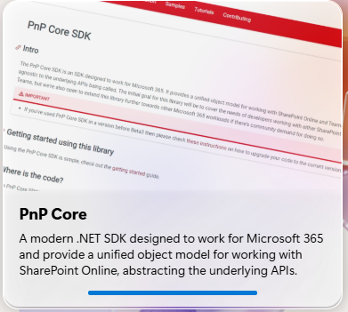
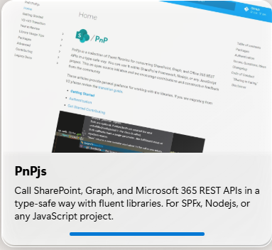
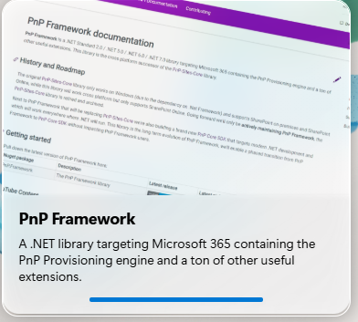

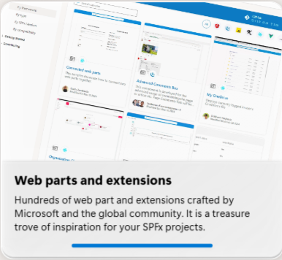

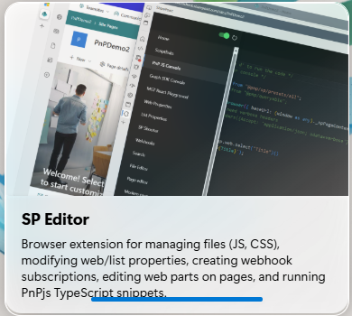
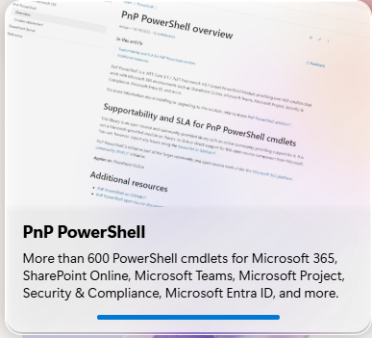
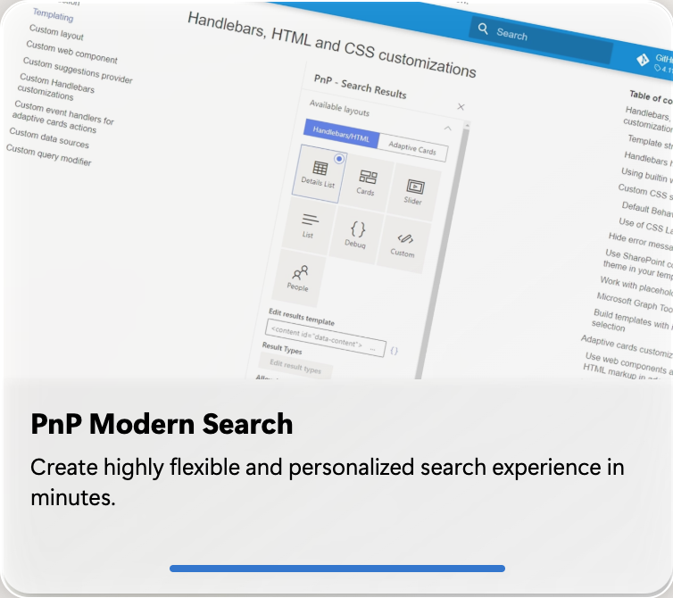
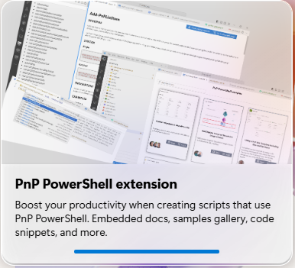
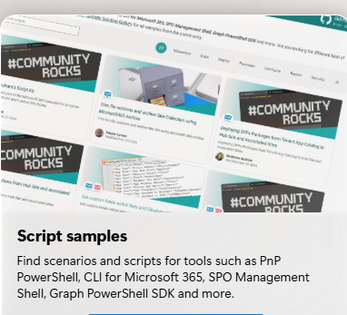
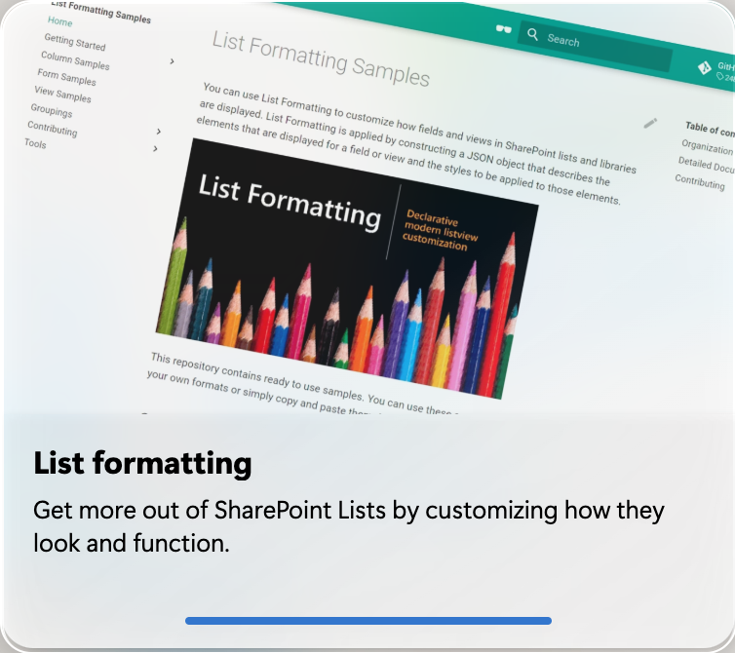

Developer focused
User-enablement
Admin-enablement
Maker focused
Notes:
Dan
PnP Framework PnPjs Core Web parts samples, SP Editor,
Kasper
PnP PowerShell, Script samples, list formatting, PnP PowerShell extension

Slide 14
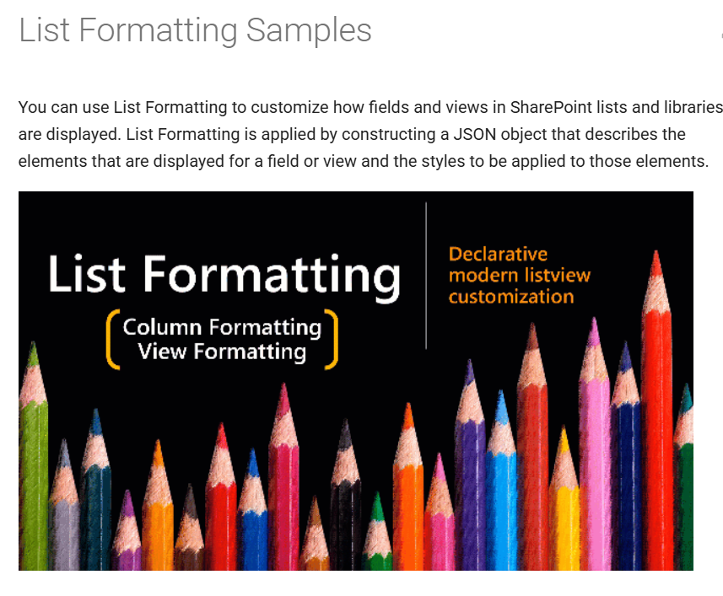
PnP Modern Search + List Formatting
Notes:
Kasper

Slide 15
Script Samples
List Ownerless Teams
Delete inactive Guest User
Replace owner on every flow in a tenant
File version trimmer
Get “everyone but external users” claim
Microsoft 365 License Monitoring and Alert Script
Notes:
Dan List Ownerless Teams | PnP Samples
300+ samples

Slide 16
Open Source in numbers
PnP PowerShell
Over 30 million downloads
Over 50 billion HTTP requests towards Microsoft 365 PER MONTH
Used in Over 40.000 tenants per Month.
PnP Modern Search
Most widely used 3p SPFx customization in the world
There are 10s of thousands of tenants using SPFx
PnP Script samples
Roughly 30.000 monthly users of script samples
Notes:
Dan – PnP PowerShell, PnP Scripts
Kasper - PnP Modern Search

Slide 17
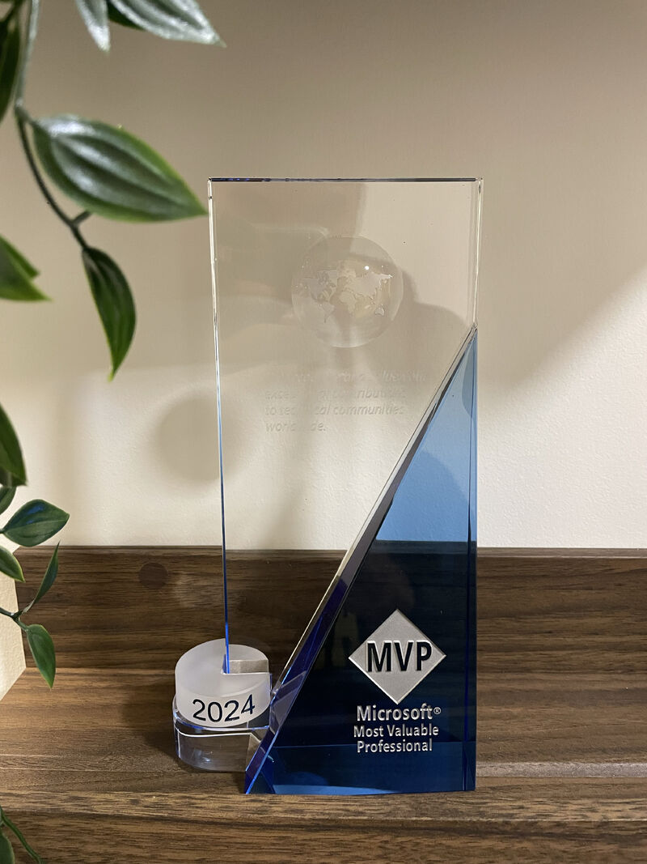
Final warning: Community can be contagious and have unforeseen consequences
Notes:
Kasper

Slide 18

Questions
aka.ms/community/home
Notes:
People waiting to ask questions at a tech conference, call experts live 2025, and being held in Copenhagen, make sure people look happy, on stage have an old white man, and a young white boy, and on the screen have a big question mark

Slide 19
Resources
Links to useful resources
Microsoft 365 & Power Platform Community
Home · pnp/docs Wiki (PnP manifesto)
Script Samples | PnP Samples
Introduction - PnP Modern Search (v4)
aka.ms/community/home

